Slide 1
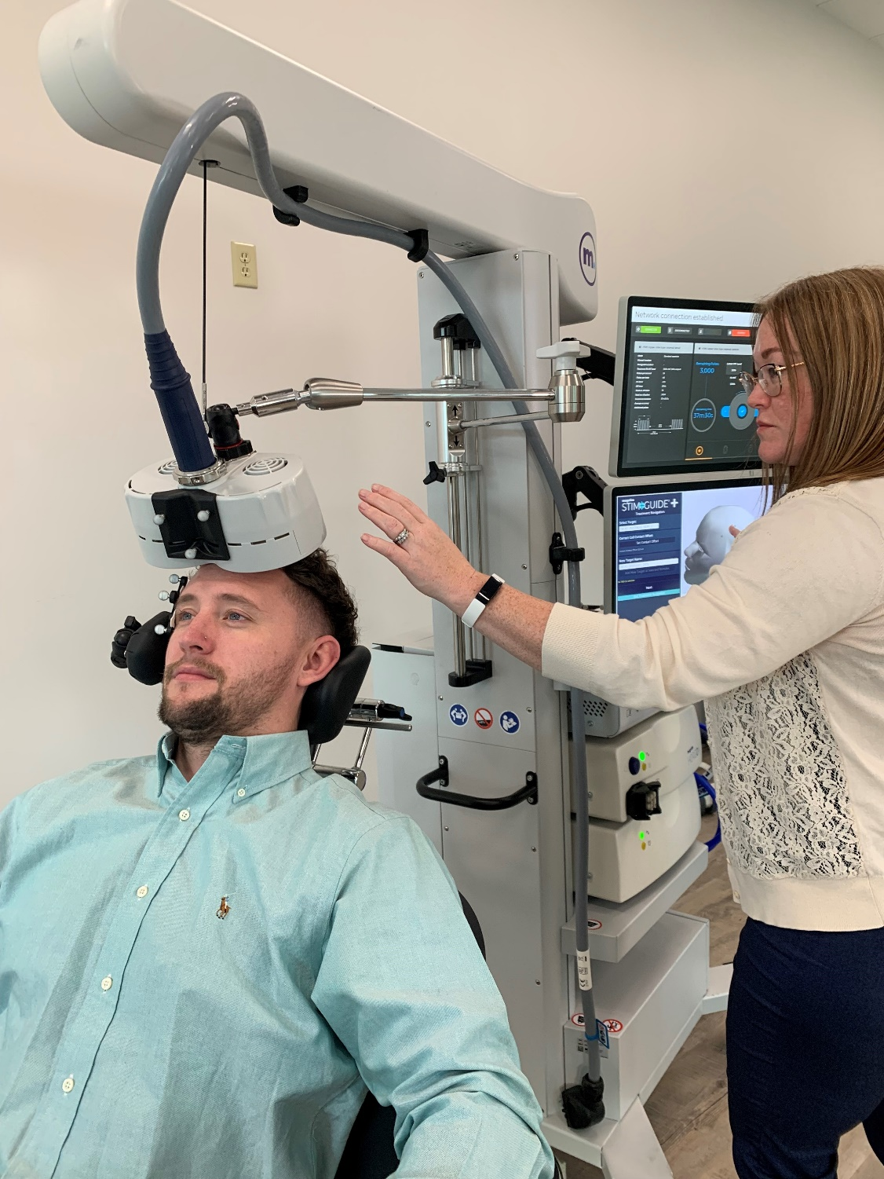
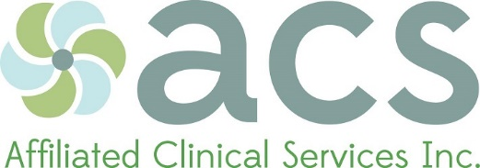

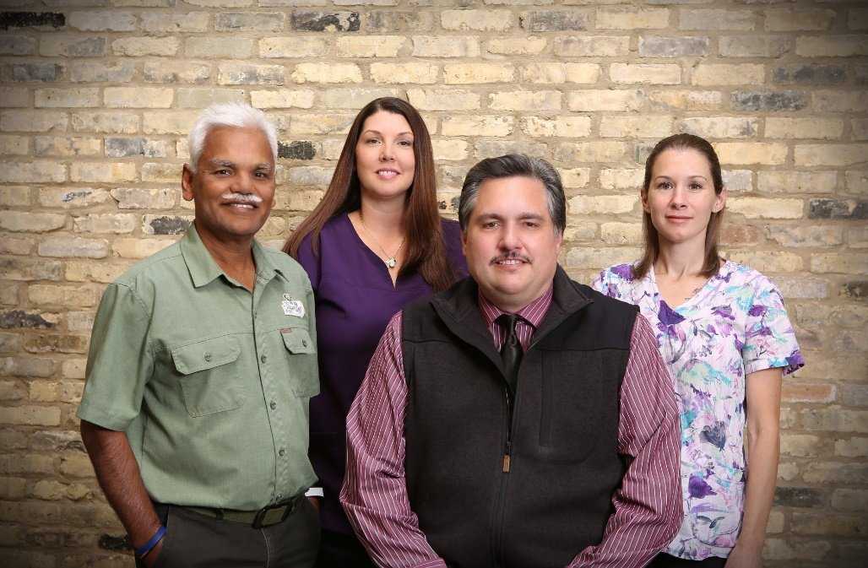
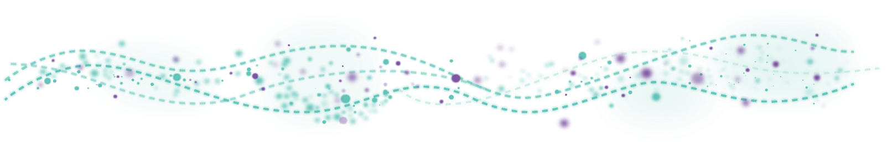
(A non-invasive FDA-approved treatment for adults with treatment-resistant MDD)
53-50229-017 Rev B
53-50229-017 Rev D
Notes:
Magstim transcranial magnetic stimulation (TMS) is an FDA-approved treatment for adults with treatment-resistant major depressive disorder (MDD). (Aetna and BCBS of IL should cover TMS for patients ages 15-17 as well!)
The first Magstim device received FDA-clearance in 1987. Magstim is considered the “gold-standard” TMS device, as it is the most widely-used TMS device in the world.

Slide 2
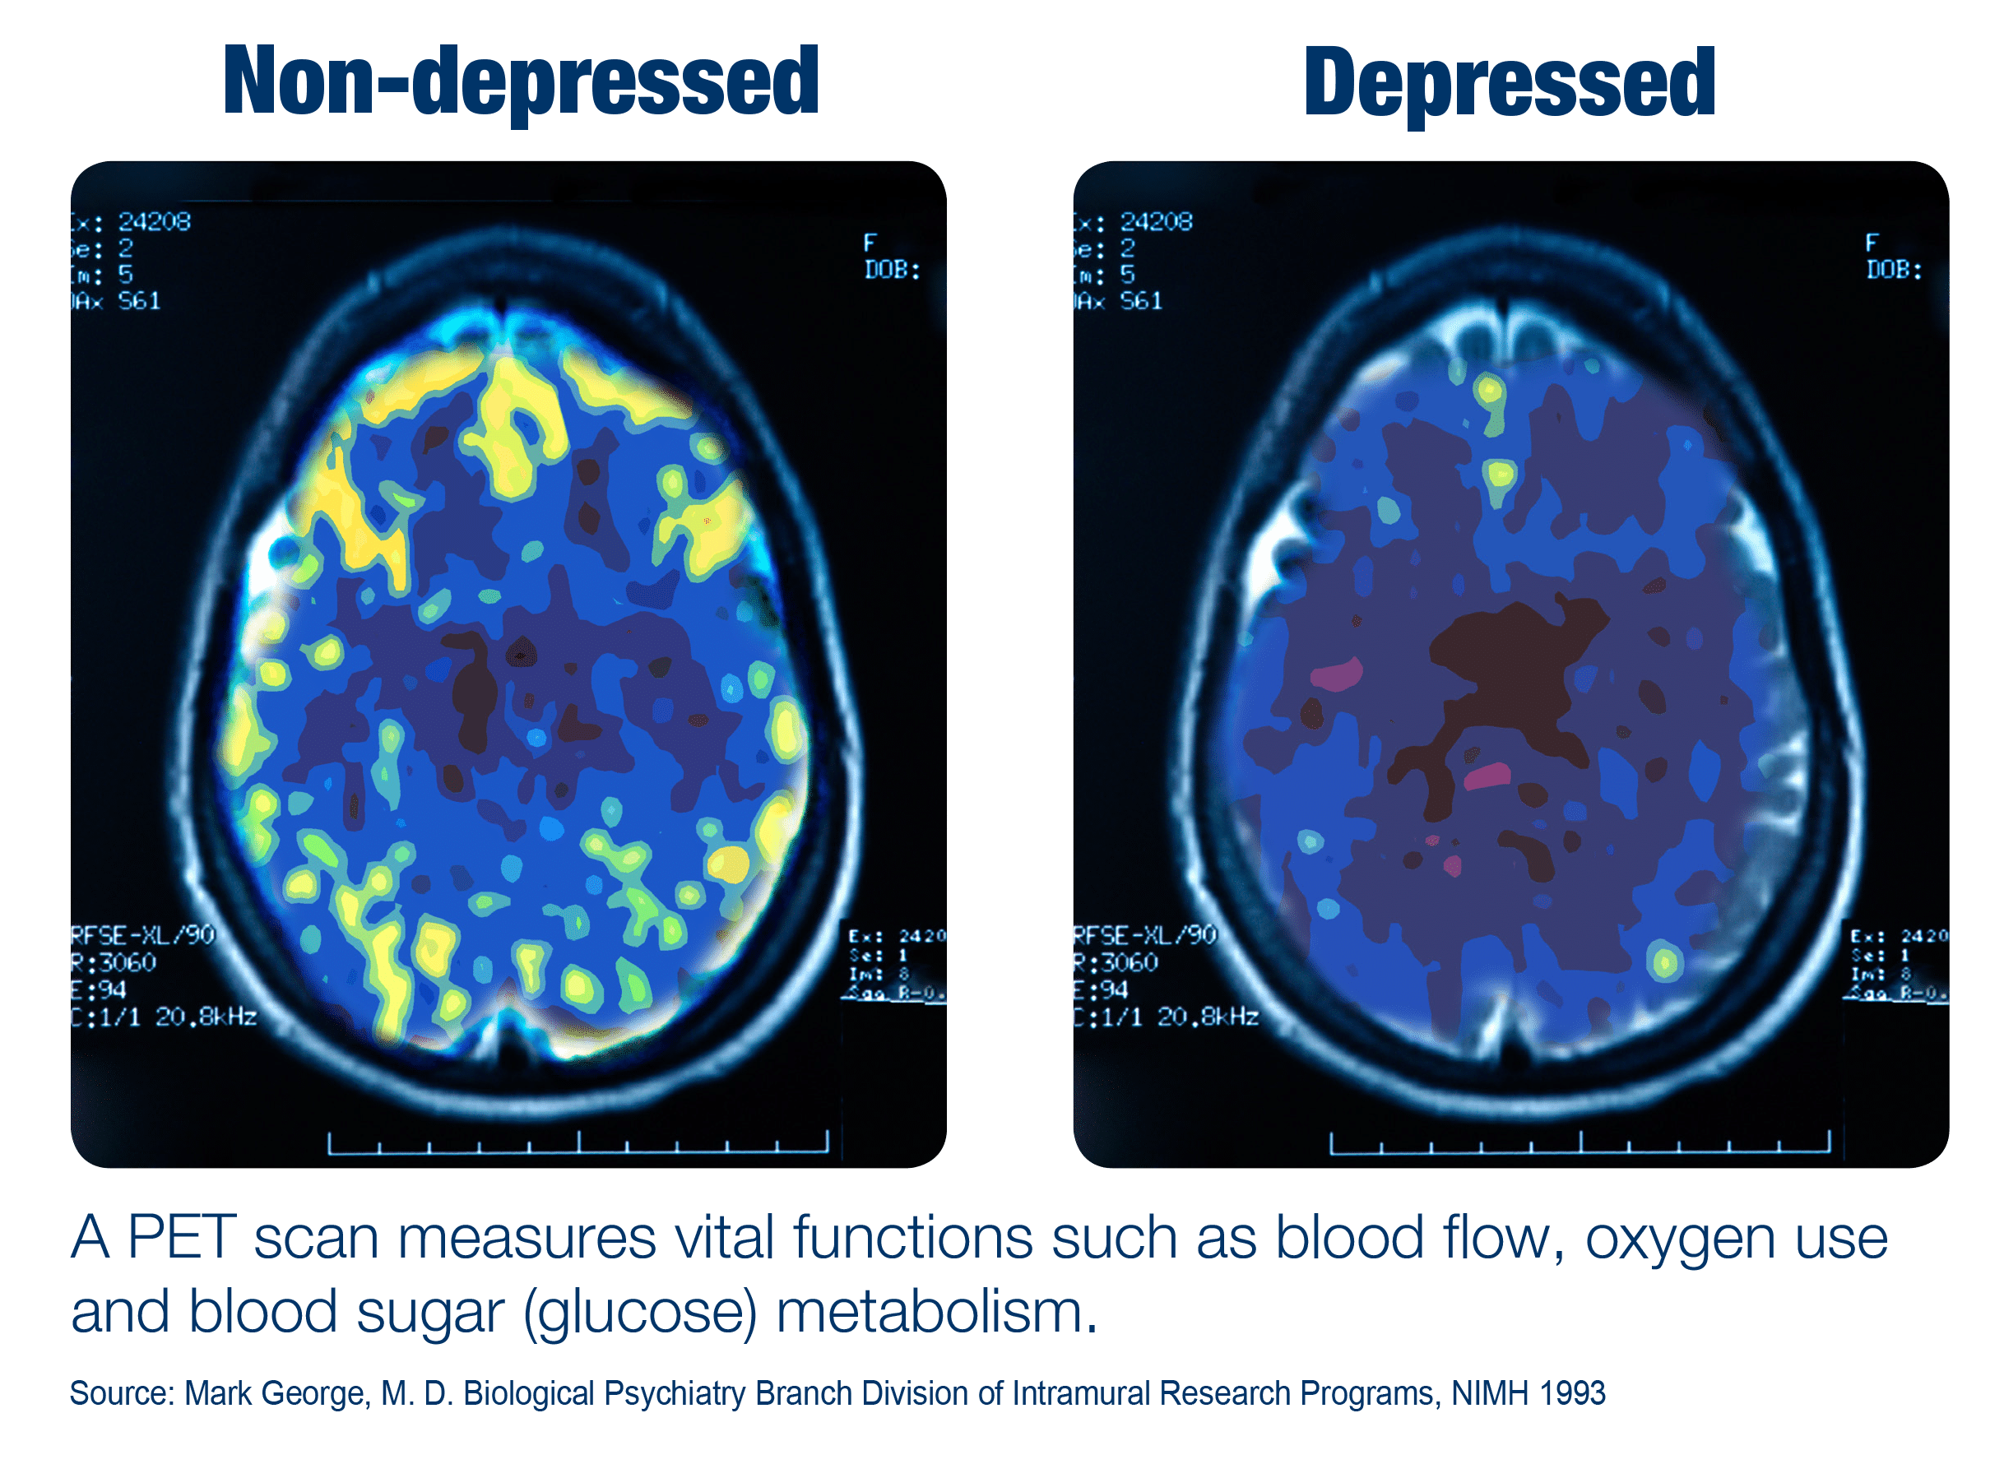
Brain activity is reduced in depression.
Low levels of neurotransmitters (“chemical messengers”) that help to regulate mood
- Serotonin
- Dopamine
- Norepinephrine
Notes:
Blood flow, oxygen, and blood sugar to the brain are also reduced in depression.

Slide 3
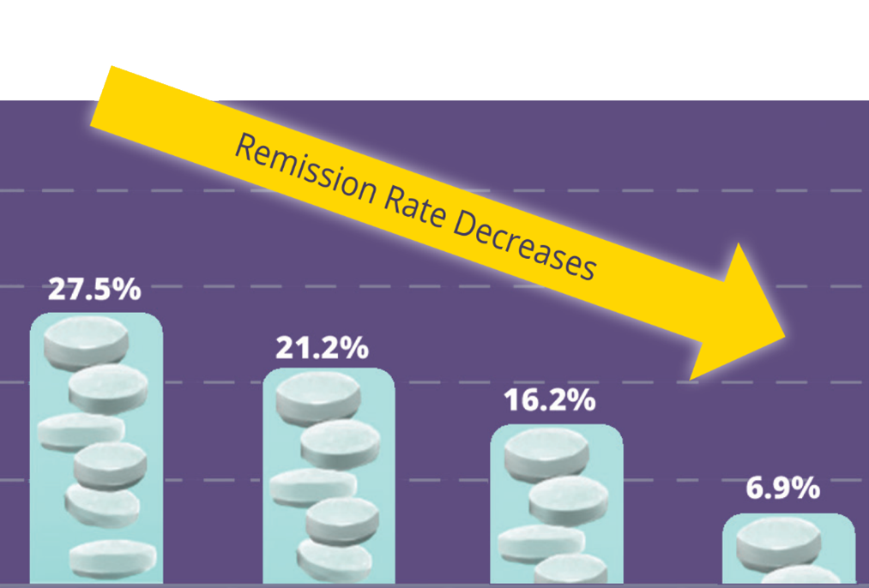
Antidepressant Medication Approach
What happens to patients with each medication?
The STAR*D study showed that every time a patient tries a new medication, their chances of remission goes down.
50%
40%
30%
20%
10%
0
Achieving remission (HAMD 17)
First-Line
Treatment
Effect¹
N=2,876
1-Prior
Treatment
Failure²
N=727
2-Prior
Treatment
Failure³
N=221
3-Prior
Treatment
Failure⁴
N=58
Notes:
During a patient’s 4th antidepressant med trial, the chances of them reaching remission from depression is <7%!

Slide 4
Antidepressant Medication Trials
- Decreased remission rates
- More likely to d/c due to side effects
STAR*D also showed discontinuation due to side effects increase with each treatment attempt
50%
40%
30%
20%
10%
0
Discontinuation due to side effects
increases with each treatment attempt
41.4%
35.2%
Discontinuation due to side effects (%)
23.1%
8.6%
First-Line
Treatment
Effect^{1,3}
N=2,876
1-Prior
Treatment
Failure^{1,3}
N=727
2-Prior
Treatment
Failure^{1,3}
N=221
3-Prior
Treatment
Failure^{1,3}
N=58
Notes:
Additionally, w/ each subsequent antidepressant medication trial, the more likely a patient is to discontinue the medication due to intolerable side effects.

Slide 5

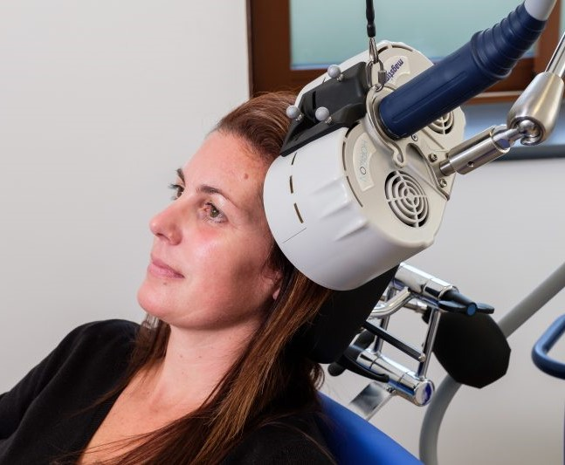
Magstim TMS Therapy helps to treat MDD patients safely and more effectively.
Transcranial Magnetic Stimulation (TMS)
Non-invasive treatment stimulates neurotransmitter release
A proven therapy with increased remission rates
No systemic side effects of antidepressant medications
Notes:
How it works- A closed, magnetic coil is placed on the left side of the head, over the left prefrontal cortex. The coil delivers intermittent magnetic pulses (like that of an MRI machine) to target the areas of the brain that are underactive in depression. This results in the increased production of “feel-good” chemical messengers (i.e. serotonin, dopamine, norepinephrine).
Patients will feel a tapping sensation and hear clicking noises as the pulses are being delivered.

Slide 6
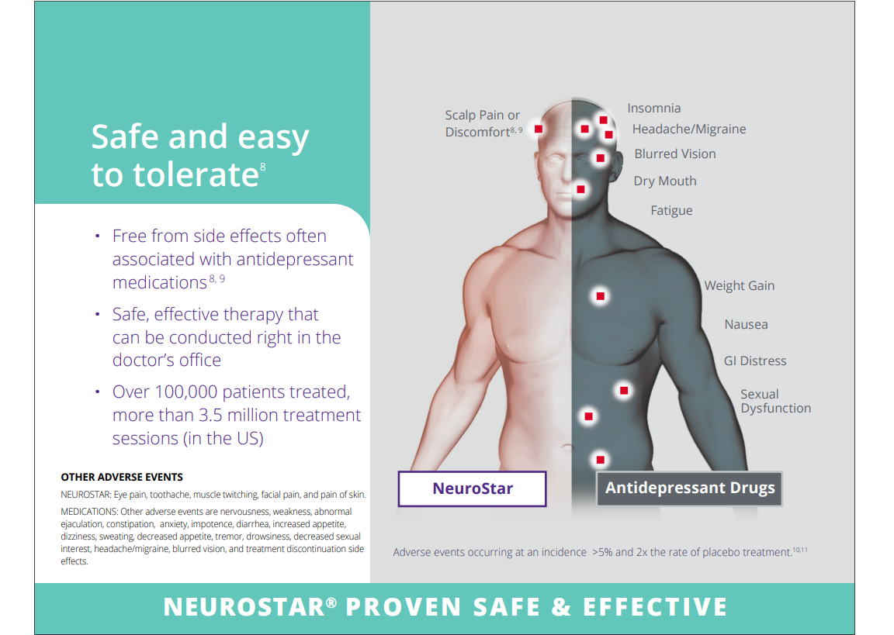

Most common Side effect is scalp pain or discomfort at treatment site
(First 1-2 weeks)
50% of patient’s may experience mild headaches (First week)
Magstim is the only TMS device with no reported seizures!
Notes:
It is recommended that a prophylactic mild analgesic medication (i.e. acetaminophen, ibuprofen) is taken 45 min. prior to scheduled TMS treatments, at least for the initial weeks.
Only during TMS pulsing, facial twitching (left brow/lower jaw) is normal, but minor adjustments can be made if it is causing discomfort.
Magstim is the only TMS device with no reported seizures, because it monitors four coil position parameters consistently during treatment. The overall chance of seizure with a standard TMS device under ordinary clinical use is approximately < 0.1%.
TMS is different from electroconvulsive therapy (ECT) in the following ways- TMS uses a magnetic coil vs. electric currents. TMS does NOT induce a seizure; in fact, we take special precautions to reduce the risks of seizures. General anesthesia is NOT used for TMS; patients are awake during treatments. There is no recovery time needed post TMS treatments; therefore, there are no driving restrictions. Lastly, TMS is NOT associated with memory loss/confusion, a well-known side effect of ECT.
Mood fluctuations can be common during the first half of TMS, as your brain is essentially being re-wired. Moods should then level out and improve.
Some may experience the “TMS dip” – a temporary worsening of depressive symptoms. This is normal and usually precedes when one starts to experience the noticeable, positive changes of TMS.

Slide 7
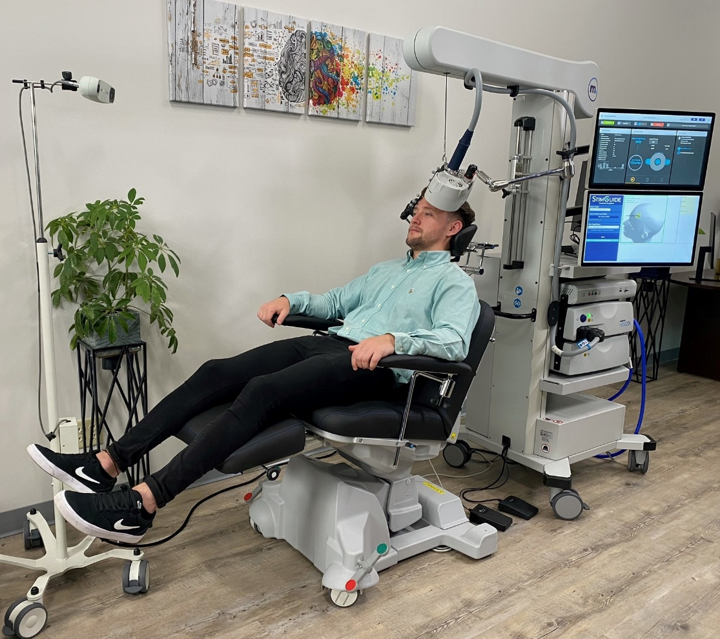
Magstim TMS Therapy
Treatment Overview
Motor threshold (MT) determination & initial treatment
Treatments typically take about 19 minutes
6 weeks of daily treatments (M-F) followed by three-week taper period
36 sessions over ~9 weeks
Notes:
Motor threshold (MT) determination (aka TMS “Mapping”)= Determining the minimum amt. of stimulation intensity to elicit an involuntary motor response in the right hand (specifically the R. thumb/index finger) as an adequate indicator of finding the correct treatment location (lt. prefrontal cortex).
The mapping appt. is longer than a standard treatment session (approx. 1.5-2 hours total). This includes the first treatment that a patient will receive following their mapping.

Slide 8
At the end of treatment course
- > 2/3 will respond
-1/2 of responders will achieve remission!
Notes:
Progress is primarily measured by weekly Patient Health Questionnaire (PHQ-9) scores. (PHQ-9 scoring: Highest 27, lowest 0)
“Responding” to treatment means that patients will experience a >50% decrease in depressive symptoms.
“Remission” from depression is classified as a score of 4 or less on a PHQ-9.
When does one start to notice a difference?
- It’s extremely individualized! The average is by the 20th treatment (end of the 4th week).
- Option of adding intermittent theta-burst stimulation priming (iTBS-P) augmentation if a patient is not noticing much of a difference by that time. Patients will receive 3 min. of lower intensity pulses (80% MT) immediately prior to the standard dash protocol (19 min. at 120% MT) for the remainder of their treatments. This primes the cortex of the brain to be more receptive to the effects of the standard protocol.
Craig Groskreutz, PsyD, LPC heads the TMS research program at ACS. This involves obtaining a baseline & ending Symptom Checklist (SCL)-90-R & a weekly Beck Depression Inventory (BDI) from the patients that consent to participate. In addition to the anti-depressive benefits of TMS, the SCL-90-R is currently showing a 12-23% symptom reduction in ALL other areas as well- somatization, obsessive-compulsive, interpersonal sensitivity, anxiety, hostility, phobic anxiety, paranoid ideation (highest reduction), & psychoticism. BDI’s show an overall symptom reduction of 59% from wk. 1 to wk. 11.
Per national statistics, approx. 1/3 of patients treated will end up needing a second course of TMS at least 6 months after the first (the re-treatment rate at ACS tends to be much lower). Ins. should cover it if the patient responded to a previous acute course of TMS.

Slide 9

Common Insurance Criteria
MDD Diagnosis
Psych med trials
Baseline PHQ-9
Adequate psychotherapy trial
No contraindications
    *ALWAYS refer to patient’s coverage policy*
Notes:
Diagnosis: Severe MDD. Single episode (F32.2) or recurrent episode (F33.2) w/out psychotic features.
Med Trials: Most Ins. companies require 2-4 failed psych meds from at least 2 different agent classes in the current episode OR documented inability to tolerate 2-4 psych meds from at least 2 different agent classes. (ACS will request records for history of psych meds and psychotherapy at the time of consult.) (Important Note: Patients should remain on prescribed psych meds during the entire course of TMS, w/out any med changes, as to not affect treatment dosage or increase risk of seizure. Even if patients respond well to TMS treatment, studies have shown that 85% of patients find it beneficial to remain on at least a low-dose maintenance antidepressant to help retain symptom relief.)
PHQ-9: Ideally ≥ 15 (or BDI of at least 25.) It would be a good idea to consider having your patients periodically fill out a PHQ-9 (i.e., when updating treatment plans every 90 days).
Psychotherapy Trial: Ins. companies don’t seem to specify what constitutes as a psychotherapy trial of adequate frequency and duration. Based on experience, 6 weekly/bi-weekly sessions normally suffice.
Contraindications: Implanted/non-removable ferromagnetic metal objects near the head or neck (may allow for conditional use of titanium skull plates and cervical fixation devices/plates); immediate suicide risk; current psychosis; currently dependent upon/abusing substances (depending on the substance, patient may need to attain and maintain sobriety prior to and for the duration of TMS treatment via random UDS).
OCD, anxious depression, & substance use disorders have all recently received FDA approval, but additional clinical studies are needed. It’s currently off-label to treat, so Ins. won’t yet cover. (BCBS of IL will cover OCD). Patients would have to pay OOP ($12.6k-$12.7k after the10-15% self-pay discount).
Bipolar disorder is NOT yet FDA approved. The FDA issued clearance to Neuronetics (NeuroStar TMS device Mfr.) to begin a clinical study, but the study has not yet commenced, nor do they know when it will take place.
If you are not sure if your patients would potentially meet Ins. criteria for TMS, that is okay! Simply ref your patient(s) to us, and the ACS TMS Team will look into it for you.

Slide 10
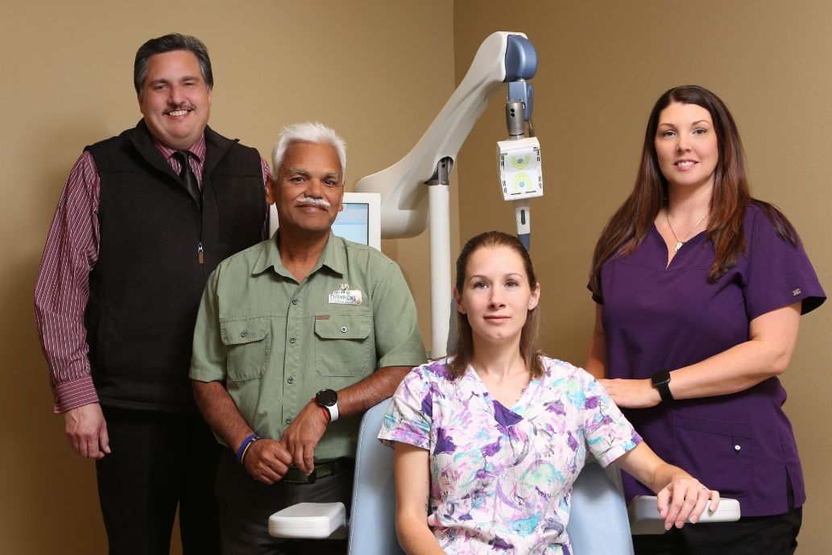
TMS PROCESS
(From start to finish)
Referral (Danielle Jensen/Jackie Naumann, Ext. 206)
Set up FREE consult
During consult- Overview, PHQ-9, obtain pertinent history, check Ins. benefits
Discuss costs
Schedule
Psych eval (MD will NOT take over)
Submit PA request
Follow-up w/ pt. & referring provider
TMS mapping & subsequent treatments
Referring provider follow-up
TMS follow-up appt.
Notes:
If you believe you have a patient that may meet TMS eligibility requirements, please provide Danielle Jensen/Jackie Naumann with patient contact info. (INTERNAL PROVIDERS, please send email w/ pt. initials & id number. EXTERNAL PROVIDERS, please fax over a signed ROI for referring pt. so that we are able to contact pt. OR have pt. contact us directly.)
TMS treatment team will call pt. to pre-screen & set up a FREE TMS consult.
During consult- Overview of TMS, PHQ-9, psych/medical history (ROIs), fill out benefits investigation form w/ patients Ins. info.
Kari Droese/Ashley Ellefson in Billing Dept. will call pt. to discuss potential TMS-related costs after checking pt. benefits & determining whether or not prior auth is required. If needed, they will offer ‘Advance Care’ health credit card (up to 15 mo. interest-free, depending upon credit score).
Schedule pt. Notify ACS Billing Dept. (half of total amt. due day of mapping; other half 3 wks. later).
Psych eval w/ Rajesh Kumar, MD (Psychiatrist) to confirm TMS eligibility. Dr. Kumar will oversee pt. ONLY as it relates to TMS for the duration of TMS course. Please be assured that he will NOT take over psych care &/or med mgt.
Submit TMS prior auth request to Ins. Co. (Almost always required.)
Notify pt. of Ins. prior auth or denial (& subsequent need for urgent appeal, in latter case). Confidential email/fax sent to referring provider to inform of patient’s TMS start date or reason that pt. will NOT be moving fwd w/ TMS.
Day of mapping- Obtain TMS consent & baseline PHQ-9. Advise against med changes for duration of TMS Tx course & importance of consistency w/ meds, caffeine, and sleep as to not affect MT/seizure threshold (ST). (TMS treatment team will f/u w/ Dr. Kumar and w/ primary provider/prescriber as needed during TMS treatment course with important updates.)
TMS treatment team will send confidential email re: pt.’s TMS summary (INTERAL PROVIDERS) and/or send pt. w/ copy of last TMS note to bring to next f/u appt. w/ referring provider (EXTERNAL PROVIDERS).
Pt. will attend post-TMS f/u appt. w/ Dr. Kumar.
***During your scheduled appt.’s w/ prior TMS patients that have previously benefited from TMS, please regularly screen them for need for/interest in additional course of TMS.

Slide 11



TMS works best in conjunction with
-Psychotherapy
-Healthy life-style choices (Both physical & mental)

Slide 12

Maintenance TMS
Following successful acute course of TMS
Promising relapse prevention strategy
Individualized treatment protocol
Currently “off-label”
Notes:
For patients that responded to an acute course
Treatment protocol is individualized & adjusted to obtain best pt. results. Frequency & duration will be based on clinical judgment (usually bi-weekly or 1x/mo.).
Currently considered “off-label” to treat, as more clinical studies are needed to determine the most effective maintenance protocol as well as the patients who are most appropriate to receive it. Therefore, it is not yet covered by Ins. Self-pay @ $250/Tx. for iTBS-P followed by standard dash protocol –OR- $125/Tx. for stand-alone, 3-min iTBS protocol (at 120% MT). Will depend on treatment protocol best suited for pt. and/or patient affordability. Due to cost, this is an optional treatment.

Slide 13

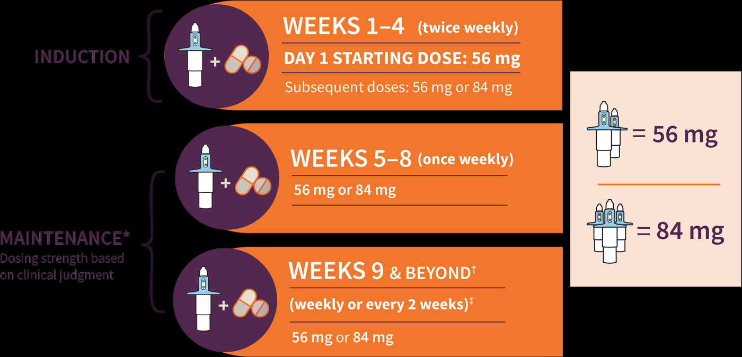
What if TMS doesn’t work?
SPRAVATO
(esketamine nasal spray)
Indications:
SPRAVATO® (esketamine) CIII Nasal Spray is indicated, in conjunction with an oral antidepressant, for the treatment of:
Treatment-resistant depression (TRD) in adults.
Depressive symptoms in adults with major depressive disorder (MDD) with acute suicidal ideation or behavior.
Notes:
SPRAVATO (esketamine nasal spray) is another option for TMS non-responders. Moderate-good results for most patients that fall under this category.
TMS is always considered first, because it’s less invasive & associated w/ less side effects. Important Note: If you have a pt. w/ severe suicidal ideation (SI), SPRAVATO > TMS, because it is proven to address SI w/in the first 24 hrs.
WARNING: SEDATION, DISSOCIATION; ABUSE AND MISUSE; and SUICIDAL THOUGHTS AND BEHAVIORS
- Risk for sedation and dissociation after administration. Monitor patients for at least two hours after administration.
SPRAVATO® is only available through a restricted program called the SPRAVATO® REMS.
Other potential side effects: Nausea/vomiting (avoid food for at least 2 hrs. before & drinking for at least 30 min. prior); increased blood pressure (monitored before, during, & after); short-term cognitive impairment; impaired ability to drive & operate machinery (arrange transport home); bladder problems; embryo-fetal toxicity; dizziness/vertigo; numbness; anxiety; lack of energy; feeling drunk.
If side effects occur, they usually happen right after taking SPRAVATO & go away same day.
SPRAVATO at ACS in Hartford Monday and Wednesdays and Tuesday-Friday in West Bend.
SPRAVATO ACS contact- Mona Davidson, P: (262) 338-2717, Ext. 113

Slide 14
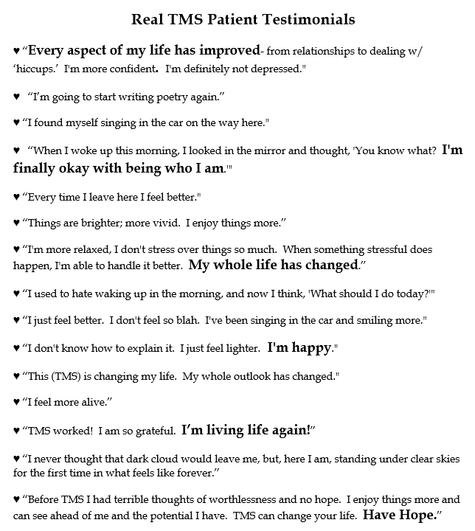

Questions?
Notes:
Please do not hesitate to reach out to us with any additional questions/concerns.
Thank you!
Danielle Jensen, RN, TMS Coordinator & Technician
djensen@affiliatedclinical.com
Jackie Naumann, CMA, TMS Technician
jnaumann@affiliatedclinical.com
Affiliated Clinical Services
111 E. Washington St.
West Bend, WI 53095
P: (262) 338-2717, Ext. 206
F: (262) 338-9767

